Slide 1
Sydney Fults Kaitlynn Smolenski
4th hour

Slide 2
Prose
One of the major divisions of genre; prose refers to a fiction and non-fiction, including all its forms

Slide 3
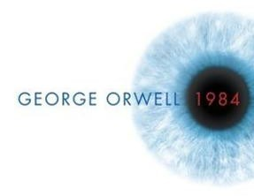
Emample
“It was a bright cold day in April, and the clocks were striking thirteen.” 1984- George Orwell

Slide 4
Pun
A play on words. Created by using a word that has two different meanings, or using two different words with similar meanings for a playful effect.

Slide 5
Example
“I was struggling to figure out how lightening works, then it struck me.”

Slide 6
Repetition
The reiteration of a word or phrase for emphasis.

Slide 7
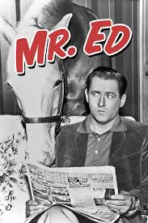
Example
Theme song of Mr. Ed, a 1960’s TV show
“A horse is a horse, of course, of course, and no one can talk to a horse of course. That is, of course, unless the horse is the famous Mister Ed.”

Slide 8
Rhetoric
Art and logic of a written or spoken argument

Slide 9
Example
MLK’s famous “I had a dream speech”
Metaphor of the “bad check”

Slide 10
1. Prose a. The reiteration of a word or phrase for emphasis.
2. Pun b. One of the major divisions of genre; prose refers to a fiction and non-fiction, including all its forms
3. Repetition c. Art and logic of a written or spoken argument
4.Rhetoric d. A play on words. Created by using a word that has two different meanings, or using two different words with similar meanings for a playful effect.

Slide 11
Works cited
“1984 Book” sffbookreview.wordpress.com 6 January 2016
http://sffbookreview.wordpress.com/2012/08/20/george-orwell-1984/
“Examples of Prose” literarydevices.net, n.d. Web 6 January 2016
http://literarydevices.net/prose/
“Examples of Puns” YourDictionary, n.d. Web 6 January 2016
http://examples.yourdictionary.com/examplrd-of-puns.html
“Examples of Repetition” literarydevices.net, n.d. Web 6 January 2016
http://literarydevices.net/repetition/
“Mr. Ed Theme Song” imbd.come 6 January 2016
http://www.imbd.com/title/tt00054557/trivia

