Slide 1
Terms 58-62
By Carlos Agens and Nick Palencar
January 11, 2016
AP Language

Slide 2
Sarcasm
Literal translation is “tearing of the flesh”.
Something that needs to be recognized while reading information.
One of the few weapons that authorities have left.

Slide 3
Sarcasm explained—instructors should never use sarcasm.

Slide 4
Satire
When you make fun of something to make a point.

Slide 5
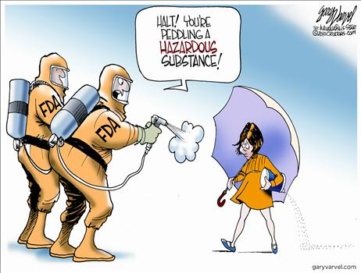
Satire, explained (The sinister Morton’s Salt girl)

Slide 6
Semantics
This is the intense study of word origins, meanings, etc.
Often academic

Slide 7
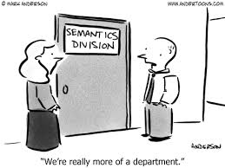
Semantics, explained

Slide 8
Simile
A comparison using “like” or “as”.
NOT a metaphor
Metaphors are simply comparisons.

Slide 9
Simile, explained

Slide 10
Speaker
This is the entity that delivers the message
NOT necessarily the author
Sometimes easy to recognize, sometimes not

Slide 11
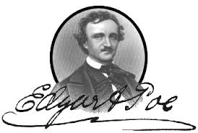
Speaker, explained(Poe was often confused with his narrators—made him seem crazier)

Slide 12
Quiz
Word Bank: Sarcasm Satire Semantics
Simile Speaker
A comparison using like or as:___________.
To make fun of something for a point:_____.
Literally, the “tearing of the flesh”:________.
The deliverer of the message:____________.
Finer shades of meaning entail:___________.

Slide 13
Works Cited
Anderson, Mark. “Word Cartoon 2005.”
andertoons.com. N.D. Web. 10 January 2016.
The Edgar Allan Poe Society of Baltimore. “Edgar Allan Poe Image.” eapoe.org. 1 January 2016. Web. 16 January 2016.
“If you are too dumb to recognize sarcasm.” quickme.com. N.D. Web. 10 January 2016.
Payne, Laura. “Comparing Metaphors and Similes.” K5learning.com. N.D. Web. 10 January 2016.

Slide 14
Works Cited, cont.
Varvel, Gary. “Morton’s Salt.” townhall.com. 22 April 2010. Web. 10 January 2016.

