Slide 1
Analysis of “The Nun’s Priest’s Tale”
By Geoffrey Chaucer

Slide 2
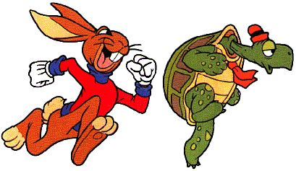
Genre
Beast Fable
Mock Epic
Short story with animal characters who act like humans – allows for criticism/scrutiny of human behavior

Slide 3
Sources
A variety, ranging from the Bible to Aesop.
Numerous allusions to
other literary works

Slide 4
Structure
Opening in Barnyard
Fox
Dream Discussion
Seizing of Chanticleer
Escape of Chanticleer
Flattery

Slide 5
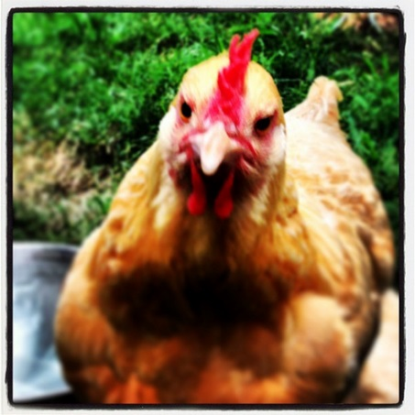
Skeptical Wife
Argument between husband and wife (rooster and hen)
Comical because you have animals arguing as if they were an old married couple
Husband believes dreams have significance; wife thinks dreams are just dreams (no reason for concern or additional thought)

Slide 6
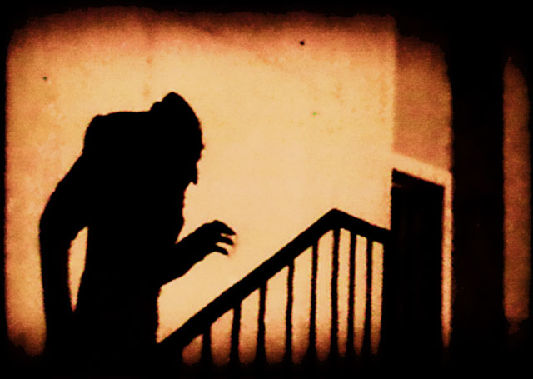
What’s Up with Those Dreams?

Slide 7
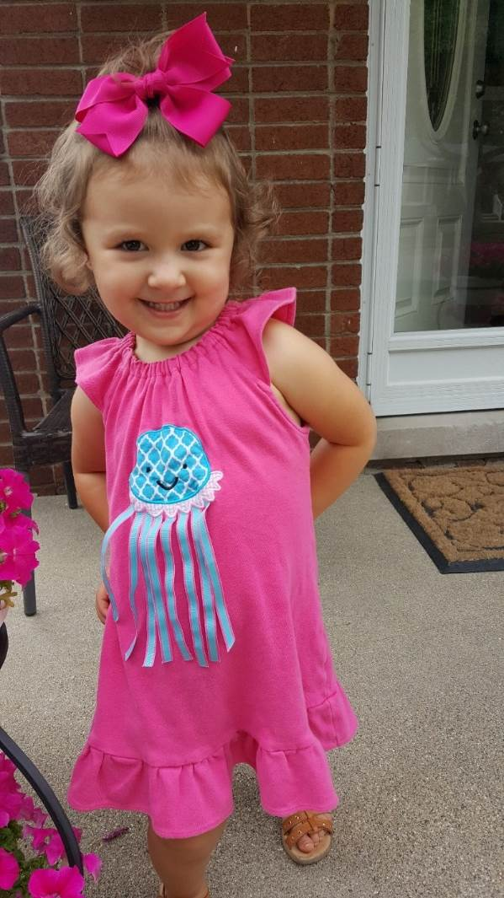
Sweet Dreams?
In her dream, she said that Jesus gave her a flower Band-Aid.

Slide 8
Nightmares?
Ernie lamp
Old house in Wyandotte
Ernie lamp talked to me in my dream
Sat across from on the floor
Looked me in the eye
Told me that my cousin, Phil, was going to die
I didn’t sleep well that night

Slide 9
Night Terrors
Intense episodes of fear
Screaming or yelling
Physical movement (leaping)

Slide 10
Recurring Dreams
Same nightmare – being chased (it’s dark, you don’t know who’s chasing you, feeling that you can’t escape, etc.)
Definite pattern

Slide 11
Themes and Style
Woman is to blame for the Fall of Man
Frequently “ludicrous”
Barnyard vs. philosophical

Slide 12
Chanticleer in Trouble
Rooster (main character) finds himself in a tough spot – natural predator goes after him
Needs a plan to escape adverse situation
?

Slide 13
Moral or lesson
Flattery will get you nowhere
Keep your mouth shut and your ears open

Slide 14
Here Endeth the Lesson
Produced by Chaucer, Inc.
Directed by Mr. Jackson and Mr. Danz
Copyright MCMLXXXIII, all rights reserved.

