Slide 1
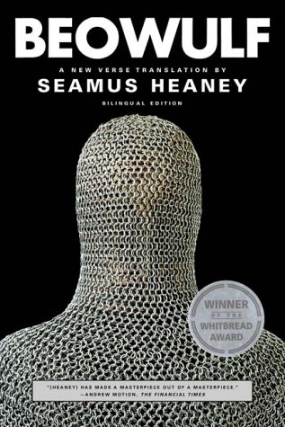
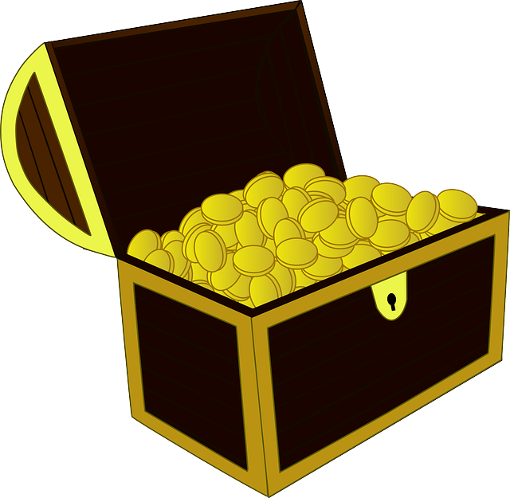
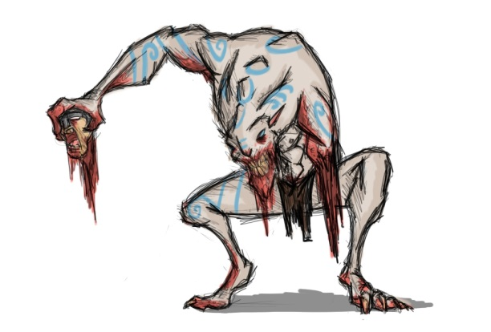
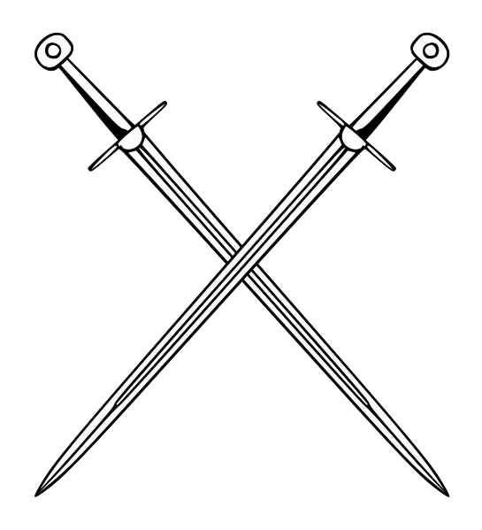
BEOWULF
Epic Hero

Slide 2
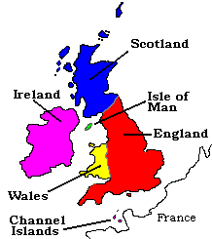
Road to the Isles
Britain attacked by seagoing marauders (from now Denmark, Germany, and Holland)
These marauders (Angles, Saxons, Jutes) push Celtic-speaking peeps from central part of island (known as England now)
The tribe known as Angles achieve cultural dominance
Later, the Saxons achieve cultural dominance
So the period/culture is referred to as Anglo-Saxon

Slide 3
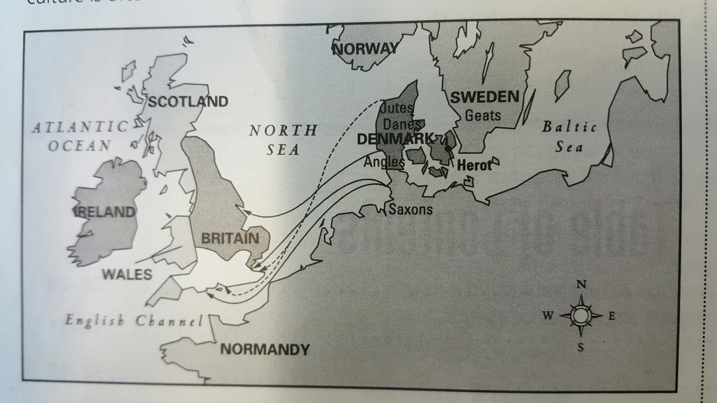

Slide 4
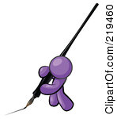
Old English Y’all
Original form of Beowulf is in Old English (what the Anglo-Saxons spoke)
It’s been translated into modern English (so thankful!)
Seamus Heaney book has the Old English version

Slide 5
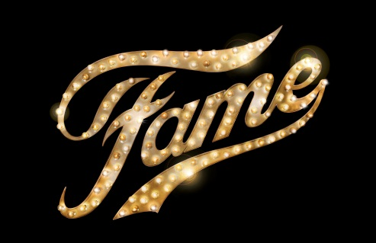
A Fateful Folk
Anglo-Saxons bring pagan gods/beliefs
Anglo-Saxon warrior code – reciprocal relationship between lord and king (reciprocity)
Ultimate fate (wyrd) is death
Emphasis on acquiring fame to stave off fate (temporarily) and achieve immortality by way of legacy

Slide 6
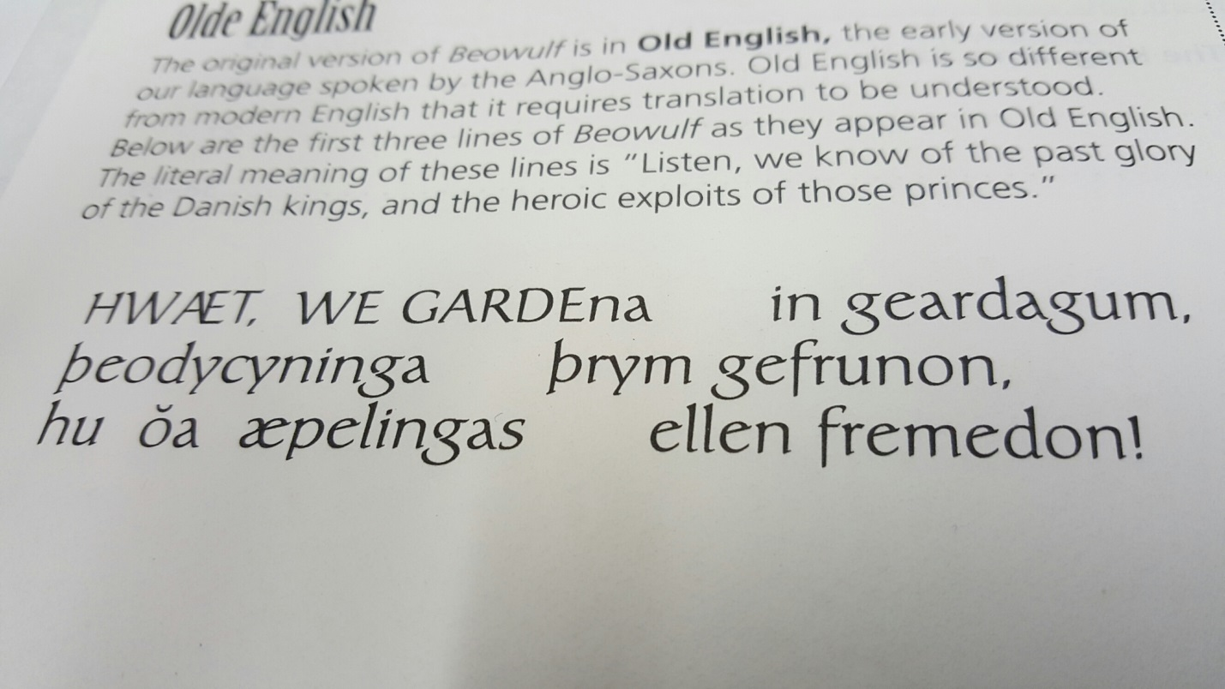
Literary Concepts
Caesura –strong rhythm marked by a pause or break near the middle of every line

Slide 7
Concepts Continued
Alliteration – the repetition of sounds at the start of nearby words
This is definitely present in the Old English, but modern translators try to duplicate it
Chapter 2, line 118-119
“He found them sprawled in sleep, suspecting nothing…”

Slide 8
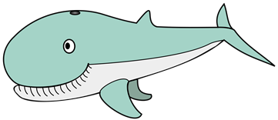
Terms Continued
Epithets – identifying expressions alongside or in place of the names of people, places, or objects that came up often in a poem (i.e. Beowulf is called “Edgetho’s son” and kings are called “ring-givers”)
Kennings – metaphoric compound words in place of simple nouns (i.e. the sea is called “the whale-road” and the sun “heaven’s candle”

Slide 9
Christian References?
After settling in England, Anglo-Saxons accept Christianity and a more peaceful way of life
Anonymous author of Beowulf was a Christian Anglo-Saxon, but the tale is set in pre-Christian times among pagan forebears.
Beowulf is a Geat (from what is now south-western Sweden)

Slide 10
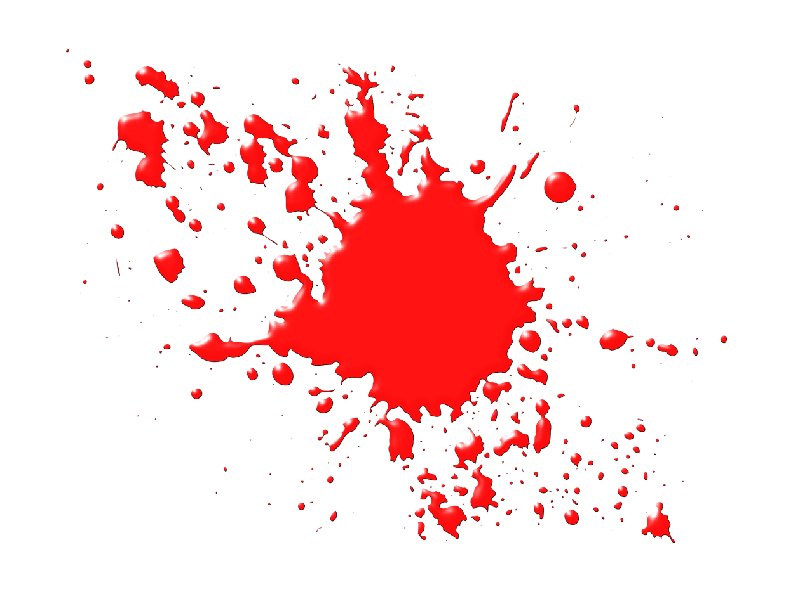
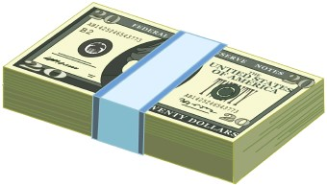
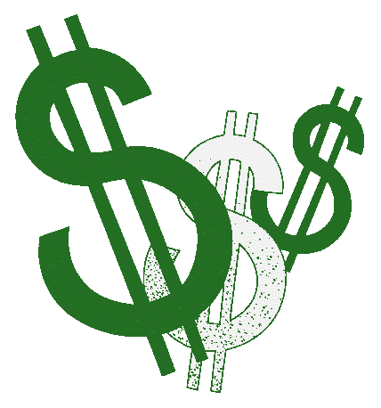
Blood Money

Slide 11
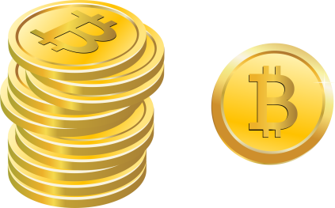
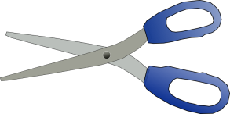
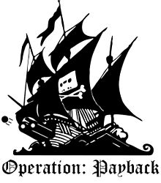
Blood Money
Germanic leaders were supposed to avenge the death of a faithful follower unless compensatory payment (wergild) was paid
Killing of close relatives, though = particularly heinous – which means wergild just won’t cut it

Slide 12
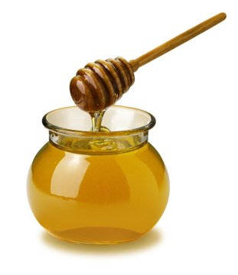
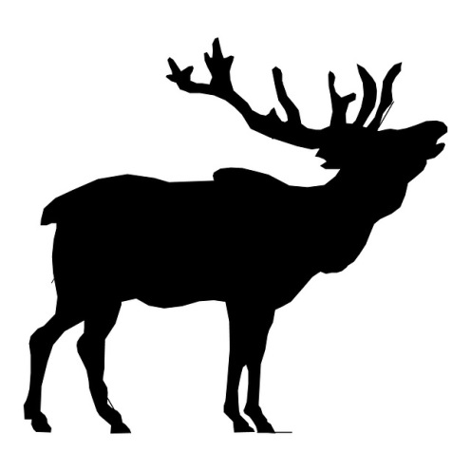
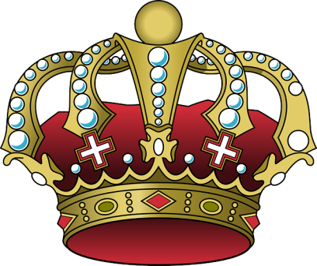
Mead-ing House
Gathering place for the Danes
Mead is served (sweet alcoholic beverage made from fermented honey)
Herot (Heorot) is Old English for “hart” or “stag” (male deer)
Deer are often associated with royalty

Slide 13
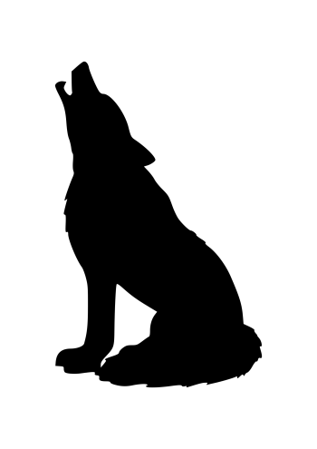
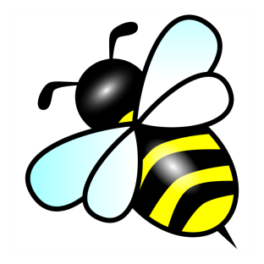
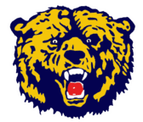
Bear It in Mind
Beowulf means “bee wolf” – which is usually interpreted as bear.
Bears are creatures that seek out bees for their honey
Similar to the bear, Beowulf has a ridiculously strong grip

Slide 14
Beowulf’s Attitude
Arrogant, prideful
Strong sense of self-worth
Shows some humility at times
Resume dropper
https://www.youtube.com/watch?v=Hzx8KHjQD6c

Slide 15
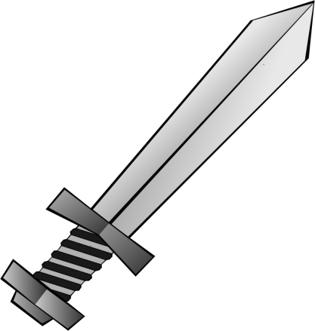
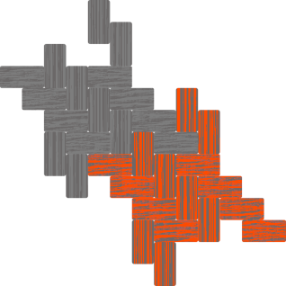
Finn-ished
In chapter 16 there’s a side story about a feud between between two kings
Touches on events described in another Anglo-Saxon poem – “The Finnsburg Fragments”
Finn (King of the Jutes and Frisians) and his brother-in-law Hnaf feud.
Finn’s followers attack the Danes under King Hnaf
Hnaf and Finn’s son both die – so Finn offers a treaty
Hengest, Hnaf’s right-hand man eventually takes revenge

